Slide 1

Handwritten Note Classification
STAT 602 Final Presentation
By Joseph McDonald

Slide 2
Introduction Of Question
The Question: Is it possible to build a reasonably accurate classifier that predicts three things simultaneously:
The writer of a short note (40 writers)
Which of 6 phrases is written
Whether the line is written in cursive or print using the kinematic features recorded by MovAlyzer.

Slide 3
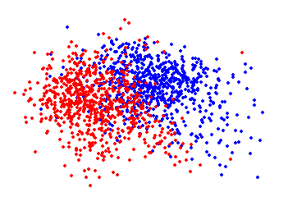
Methodology
Investigate Graphically
Establish a baseline performance
Construct family of various classifiers
Look for interactions and signals

Slide 4
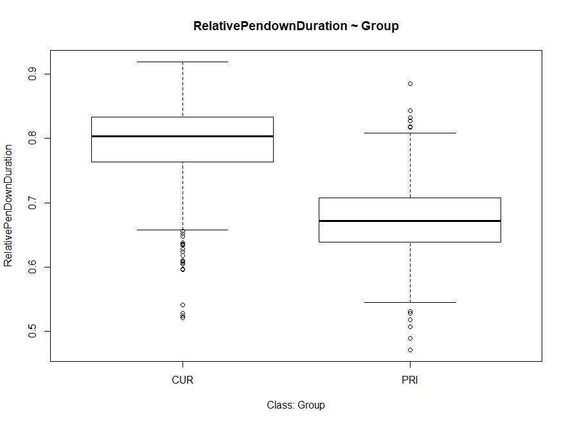
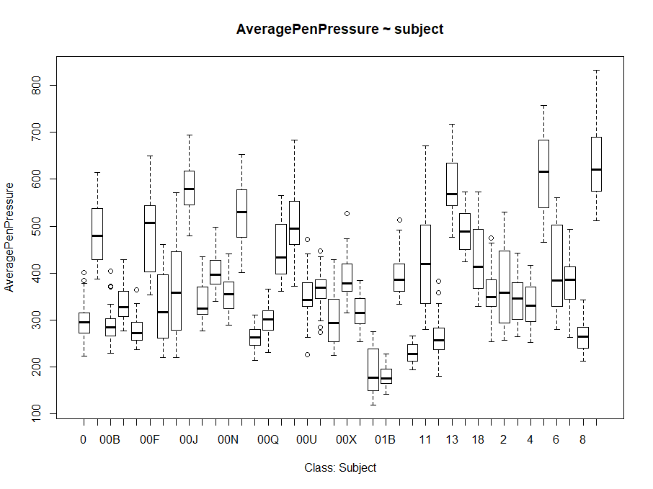
Initial Investigations
Most univariate relationships between the dependent and independent variables showed no meaningful separation.
RelativePendownDuration and Group were only exception.

Slide 5
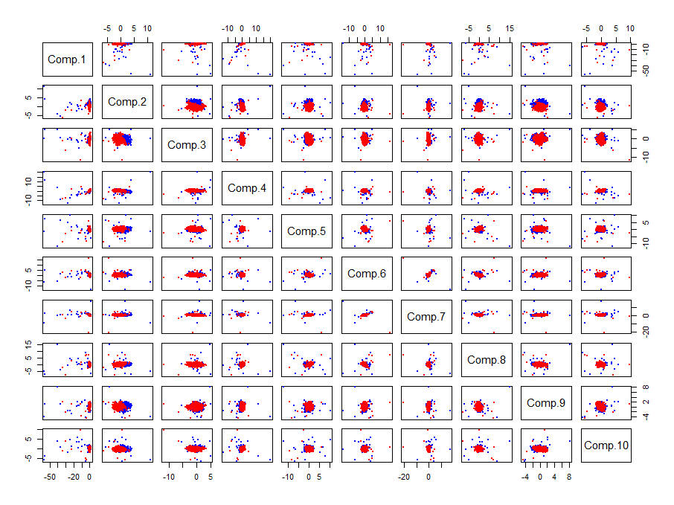
PCA
Classification of Group
Dimensionality Reduction
Key to answering question lies in high order interactions
Component 2 seems to store information about cursive vs. print

Slide 6
Classifiers Used
LDA – Establish Baseline
LDA – Optimized
KNN
MClustDA
Random Forest
Random Forest without PCA

Slide 7
LDA – Establish Baseline
Baseline model characteristics
PCA 10 components
Cross-validated
Simple
Model types
Marginal Classifiers
Joint Classifier
480 classes
Mixed marginal and joint classifiers
Did not perform well
Classifier | Accuracy
Group Marginal | .881
Subject Marginal | .385
Condition Marginal | .304
Joint | .286

Slide 8
LDA – Optimized
Optimizing principle components resulted in substantial increases in accuracy.
Joint performing better than Condition Marginal may point to hidden interaction
Classifier | Accuracy
Group Marginal | 0.924
Subject Marginal | 0.708
Condition Marginal | 0.411
Joint | 0.586

Slide 9
KNN
LOOCV
Minimal fine tuning of K for quick snapshot
Subject Marginal Suffers Likely due to high number of classes and low number of replicates
Classifier | Accuracy
Group Marginal | 0.937
Subject Marginal | 0.624
Condition Marginal | 0.484
Joint | 0.344

Slide 10
MClustDA
Computationally expensive
Dimensionality Reduction needed for further analysis outside scope of question
Some signal still present as models on par with other classifiers
Classifier | Accuracy
Group Marginal | 0.924
Subject Marginal | 0.668
Condition Marginal | 0.443
Joint | N/a

Slide 11
Random Forest
PCA unnecessary as Random Forests remove most correlation from data
Random Forest without PCA achieve highest marginal accuracies with little fine tuning
Implications of room to improve
Classifier | Accuracy with PCA | Accuracy without PCA
Group Marginal | 0.935 | 0.946
Subject Marginal | 0.737 | 0.774
Condition Marginal | 0.554 | 0.562
Joint | 0.428 | 0.490

Slide 12
Results
 | LDA | KNN | MclustDA | Random Forest PCA | Random Forest
Group Marginal | 0.924306 | 0.936806 | 0.923611 | 0.935417 | 0.945833
Subject Marginal | 0.708333 | 0.624306 | 0.668056 | 0.736806 | 0.773611
Condition Marginal | 0.411111 | 0.484028 | 0.443056 | 0.554167 | 0.561806
Joint | 0.586111 | 0.34375 | NA | 0.427778 | 0.489583
Random Forest best for marginal predictions
LDA joint outperforms expectations
Final model built from compilation of Random Forest Marginals
CV Acc = 0.430

Slide 13
Final Model Selection
LDA
Joint Independent Variable
480 classes
21 Principle Components
Cross-Validated Accuracy = 0.586

Slide 14
Conclusion
Through this analysis we have shown that there does appear to be some signal in the data that would allow the construction of a reasonably accurate classifier for all three independent variables.
Next steps
Fine tuning Random Forests
Dimensionality reduction
Maximize Degrees of Freedom to better leverage MclustDA

